Slide 1
WELCOME
The DC Future Book: in association with Columbia Threadneedle Investments
Thursday 19th September 2019
www.pensionspolicyinstitute.org.uk
Twitter: #PPIlaunch @PPI_Research

Slide 2
Twitter: #PPIlaunch @PPI_Research

Slide 3
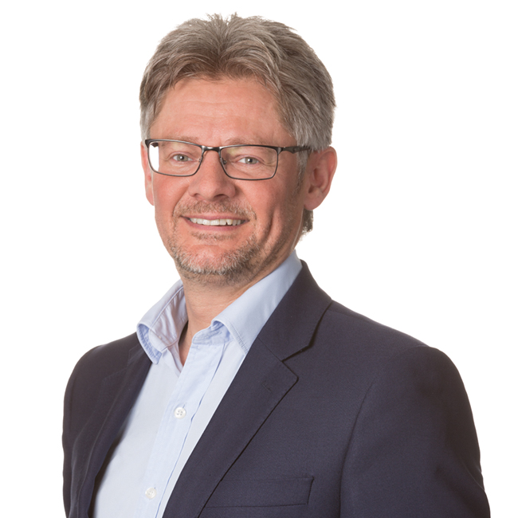
Welcome from sponsor
Chris Wagstaff
Head of Pensions & Investment Education,
Columbia Threadneedle Investments
Twitter: #PPIlaunch @PPI_Research

Slide 4
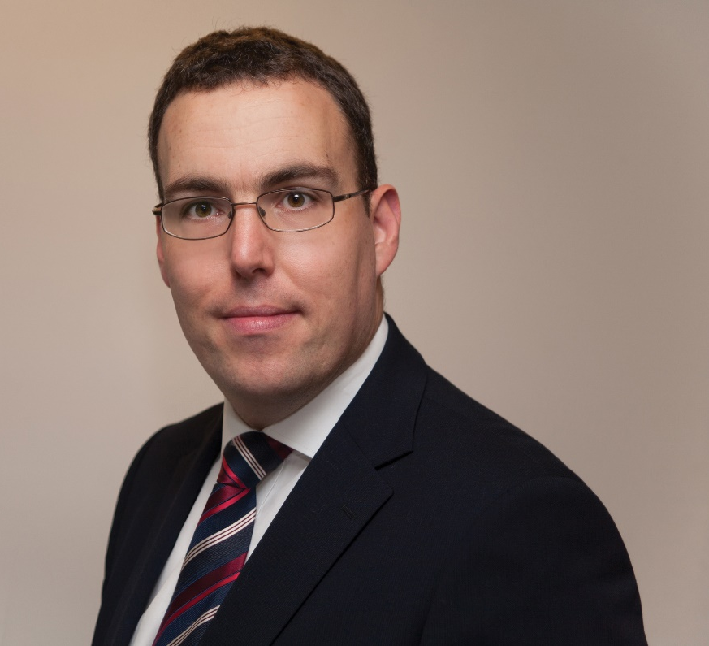
Welcome from Chair
Jonathan Stapleton
Editor-in-Chief,
Professional Pensions and Workplace Savings & Benefits
Twitter: #PPIlaunch @PPI_Research

Slide 5
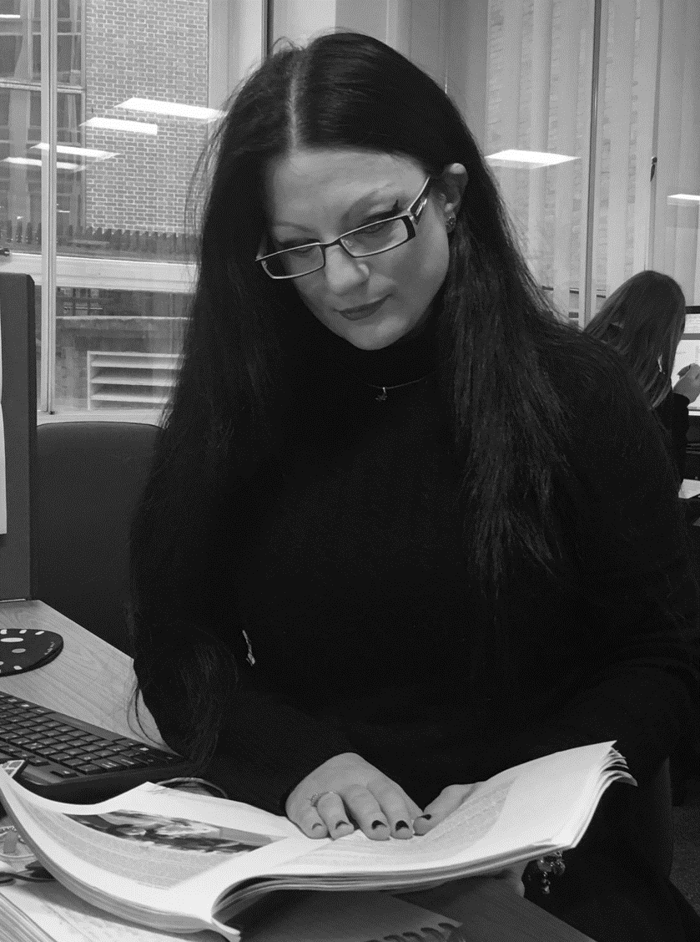
Key Findings
Daniela Silcock
Head of Policy Research,
Pensions Policy Institute
Twitter: #PPIlaunch @PPI_Research

Slide 6
This is a time of great change
Notes:
Slide 4 simply shows how the 1% charge cap introduced by the stakeholder pensions regime reduced margins very substantially. (It also more or less stopped the growth of pensions provision in the workplace dead in its tracks, but that is another story).
The headline of this slide was a comment on what happens if an industry waits for the Government or regulator to intervene. (Unlike Australia, where the providers took the initiative to eliminate the high early cessation penalties themselves, and introduced flat charges of around 2% - which looked like a stunning reduction at the time, as you will appreciate if you picture a flat line at 2% on this chart - and is only now being seriously challenged, which the industry can stand easily because of the way funds have built up)

Slide 7
The pensions landscape changes very quickly
Notes:
Slide 4 simply shows how the 1% charge cap introduced by the stakeholder pensions regime reduced margins very substantially. (It also more or less stopped the growth of pensions provision in the workplace dead in its tracks, but that is another story).
The headline of this slide was a comment on what happens if an industry waits for the Government or regulator to intervene. (Unlike Australia, where the providers took the initiative to eliminate the high early cessation penalties themselves, and introduced flat charges of around 2% - which looked like a stunning reduction at the time, as you will appreciate if you picture a flat line at 2% on this chart - and is only now being seriously challenged, which the industry can stand easily because of the way funds have built up)

Slide 8
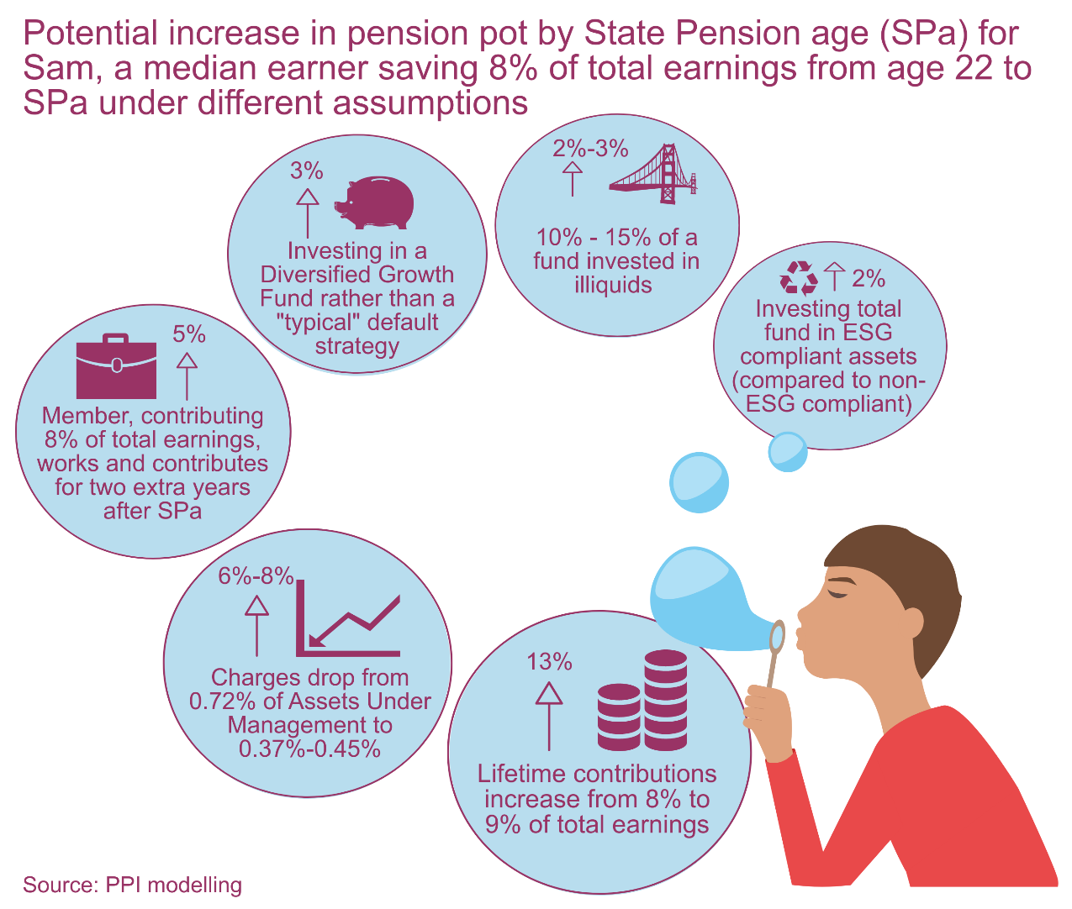
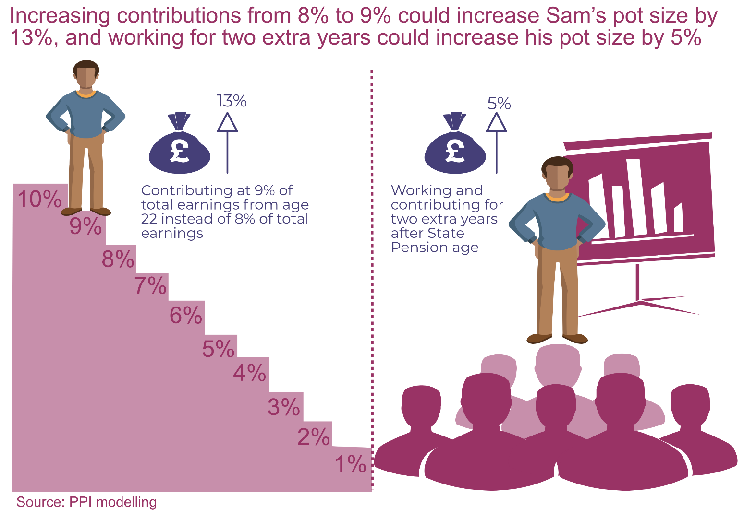
Where are we heading to?
Notes:
Slide 4 simply shows how the 1% charge cap introduced by the stakeholder pensions regime reduced margins very substantially. (It also more or less stopped the growth of pensions provision in the workplace dead in its tracks, but that is another story).
The headline of this slide was a comment on what happens if an industry waits for the Government or regulator to intervene. (Unlike Australia, where the providers took the initiative to eliminate the high early cessation penalties themselves, and introduced flat charges of around 2% - which looked like a stunning reduction at the time, as you will appreciate if you picture a flat line at 2% on this chart - and is only now being seriously challenged, which the industry can stand easily because of the way funds have built up)

Slide 9
How do we get there?
Keep discussing charges vs. returns
Evolve DC platform infrastructure for increased availability of assets
Keep moving towards a holistic view of value for money
Learn from other countries
Notes:
Slide 4 simply shows how the 1% charge cap introduced by the stakeholder pensions regime reduced margins very substantially. (It also more or less stopped the growth of pensions provision in the workplace dead in its tracks, but that is another story).
The headline of this slide was a comment on what happens if an industry waits for the Government or regulator to intervene. (Unlike Australia, where the providers took the initiative to eliminate the high early cessation penalties themselves, and introduced flat charges of around 2% - which looked like a stunning reduction at the time, as you will appreciate if you picture a flat line at 2% on this chart - and is only now being seriously challenged, which the industry can stand easily because of the way funds have built up)

Slide 10
Conclusions:
The system is adapting to landscape changes
We’ve come a long way
There is still a long way to go...
There is scope to increase DC pension pot sizes which means...
... Increasing the standard of living of future pensioners
Notes:
Slide 4 simply shows how the 1% charge cap introduced by the stakeholder pensions regime reduced margins very substantially. (It also more or less stopped the growth of pensions provision in the workplace dead in its tracks, but that is another story).
The headline of this slide was a comment on what happens if an industry waits for the Government or regulator to intervene. (Unlike Australia, where the providers took the initiative to eliminate the high early cessation penalties themselves, and introduced flat charges of around 2% - which looked like a stunning reduction at the time, as you will appreciate if you picture a flat line at 2% on this chart - and is only now being seriously challenged, which the industry can stand easily because of the way funds have built up)

Slide 11
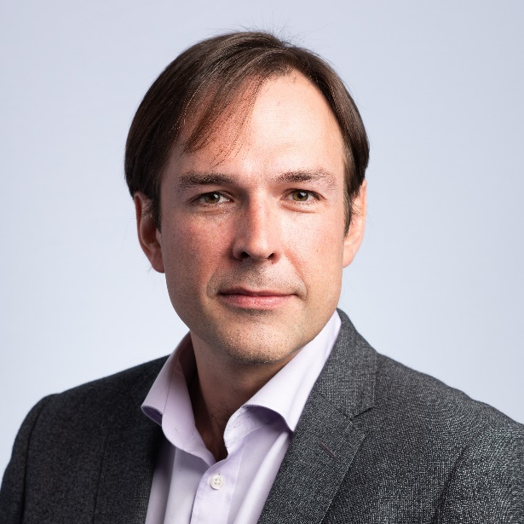
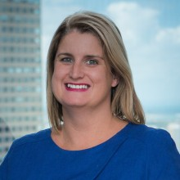
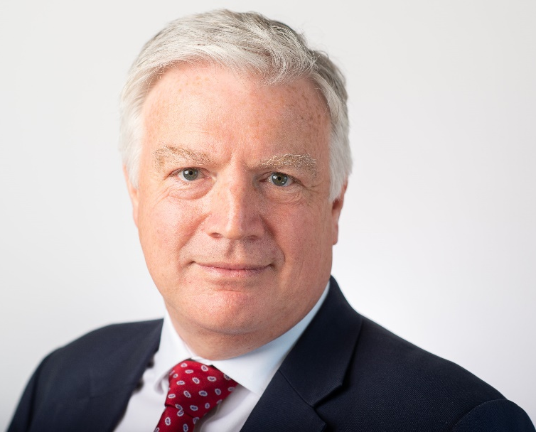
PPI
Pensions Policy Institute
Panellists opening remarks
Nico Aspinall
The People’s Pension
Trish Curry
AustralianSuper
David Fairs
The Pensions Regulator

Slide 12
The Chatham House Rule
When a meeting, or part thereof, is held under the Chatham House Rule, participants are free to use the information received, but
neither the identity nor the affiliation of the speaker(s), nor that of any other participant, may be revealed.
The remainder of the event is held under
The Chatham House Rule

Slide 13
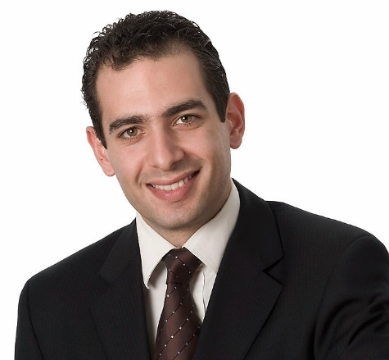
PPI
Pensions Policy Institute
Q&A Session with the panel
Nico Aspinall
The People’s Pension
Trish Curry
AustralianSuper
David Fairs
The Pensions Regulator
Andrew Brown
Columbia Threadneedle Investments
Daniela Silcock
PPI
Please observe the Chatham House Rule

Slide 14
PPI
Pensions Policy Institute
Panel and Chair closing remarks
Please observe the Chatham House Rule

Slide 15
Thank you for attending today…
Please stay and join us for a drink
Thank you to our event & research sponsors

