Slide 1


WELCOME
Pension charging structures and beyond; an
outcomes-focused analysis
Wednesday 11th September 2019
www.pensionspolicyinstitute.org.uk
Twitter: #PPIlaunch @PPI_Research

Slide 2

Twitter: #PPIlaunch @PPI_Research

Slide 3

Welcome from the Chair
Mel Duffield
Pensions Strategy Executive, USS
PPI Governor
Twitter: #PPIlaunch @PPI_Research

Slide 4
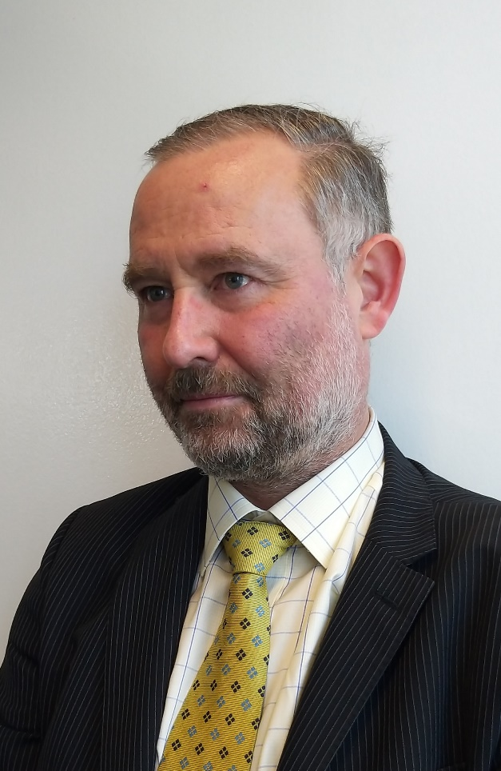
Key Findings
Mark Baker
Senior Policy Researcher
Pensions Policy Institute
Twitter: #PPIlaunch @PPI_Research

Slide 5
Automatic enrolment has seen massive changes to workplace pensions in the UK
More than 10 million new savers
99% in their scheme’s default fund
0.75% cap on charges
~
To what extent do charging structures matter?
What can be done to aid people have the retirement that meets their needs?
Notes:
Slide 4 simply shows how the 1% charge cap introduced by the stakeholder pensions regime reduced margins very substantially. (It also more or less stopped the growth of pensions provision in the workplace dead in its tracks, but that is another story).
The headline of this slide was a comment on what happens if an industry waits for the Government or regulator to intervene. (Unlike Australia, where the providers took the initiative to eliminate the high early cessation penalties themselves, and introduced flat charges of around 2% - which looked like a stunning reduction at the time, as you will appreciate if you picture a flat line at 2% on this chart - and is only now being seriously challenged, which the industry can stand easily because of the way funds have built up)

Slide 6
There are several different charging structures in DC schemes
A fixed AMC paid every year irrespective of whether contributions are made
A fixed AMC plus a flat-fee charge, irrespective of contributions.
A fixed AMC plus a percentage contribution charge levied during contributions
A variable AMC
A fixed AMC with a flat fee charge and de minimis
Notes:
Slide 4 simply shows how the 1% charge cap introduced by the stakeholder pensions regime reduced margins very substantially. (It also more or less stopped the growth of pensions provision in the workplace dead in its tracks, but that is another story).
The headline of this slide was a comment on what happens if an industry waits for the Government or regulator to intervene. (Unlike Australia, where the providers took the initiative to eliminate the high early cessation penalties themselves, and introduced flat charges of around 2% - which looked like a stunning reduction at the time, as you will appreciate if you picture a flat line at 2% on this chart - and is only now being seriously challenged, which the industry can stand easily because of the way funds have built up)

Slide 7
Charging structures do result in different outcomes, but they are not significant.
Notes:
Slide 4 simply shows how the 1% charge cap introduced by the stakeholder pensions regime reduced margins very substantially. (It also more or less stopped the growth of pensions provision in the workplace dead in its tracks, but that is another story).
The headline of this slide was a comment on what happens if an industry waits for the Government or regulator to intervene. (Unlike Australia, where the providers took the initiative to eliminate the high early cessation penalties themselves, and introduced flat charges of around 2% - which looked like a stunning reduction at the time, as you will appreciate if you picture a flat line at 2% on this chart - and is only now being seriously challenged, which the industry can stand easily because of the way funds have built up)

Slide 8
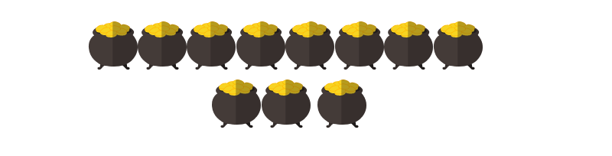
People with multiple pension pots may lose out
Each pension pot will continue to attract ongoing charges for deferred members
Multiple small pots could see people losing track of their pensions
Notes:
Slide 4 simply shows how the 1% charge cap introduced by the stakeholder pensions regime reduced margins very substantially. (It also more or less stopped the growth of pensions provision in the workplace dead in its tracks, but that is another story).
The headline of this slide was a comment on what happens if an industry waits for the Government or regulator to intervene. (Unlike Australia, where the providers took the initiative to eliminate the high early cessation penalties themselves, and introduced flat charges of around 2% - which looked like a stunning reduction at the time, as you will appreciate if you picture a flat line at 2% on this chart - and is only now being seriously challenged, which the industry can stand easily because of the way funds have built up)

Slide 9

A single pot approach can provide improved outcomes
A single pot would allow savers to keep track of their pension
People may lose out on the advantages of changing schemes
Notes:
Slide 4 simply shows how the 1% charge cap introduced by the stakeholder pensions regime reduced margins very substantially. (It also more or less stopped the growth of pensions provision in the workplace dead in its tracks, but that is another story).
The headline of this slide was a comment on what happens if an industry waits for the Government or regulator to intervene. (Unlike Australia, where the providers took the initiative to eliminate the high early cessation penalties themselves, and introduced flat charges of around 2% - which looked like a stunning reduction at the time, as you will appreciate if you picture a flat line at 2% on this chart - and is only now being seriously challenged, which the industry can stand easily because of the way funds have built up)

Slide 10

Pot-follows member can improve retirement outcomes
Consolidation into a new employer’s scheme will see fewer people with multiple pots
A new employer may operate a scheme that does not benefit larger pots
Notes:
Slide 4 simply shows how the 1% charge cap introduced by the stakeholder pensions regime reduced margins very substantially. (It also more or less stopped the growth of pensions provision in the workplace dead in its tracks, but that is another story).
The headline of this slide was a comment on what happens if an industry waits for the Government or regulator to intervene. (Unlike Australia, where the providers took the initiative to eliminate the high early cessation penalties themselves, and introduced flat charges of around 2% - which looked like a stunning reduction at the time, as you will appreciate if you picture a flat line at 2% on this chart - and is only now being seriously challenged, which the industry can stand easily because of the way funds have built up)

Slide 11
Other factors must be taken into account
Investment performance will have a significant effect
Increased contribution levels will improve outcomes
Good communication can enable people to engage
Dashboards can help, but as part of a wider package
Notes:
Slide 4 simply shows how the 1% charge cap introduced by the stakeholder pensions regime reduced margins very substantially. (It also more or less stopped the growth of pensions provision in the workplace dead in its tracks, but that is another story).
The headline of this slide was a comment on what happens if an industry waits for the Government or regulator to intervene. (Unlike Australia, where the providers took the initiative to eliminate the high early cessation penalties themselves, and introduced flat charges of around 2% - which looked like a stunning reduction at the time, as you will appreciate if you picture a flat line at 2% on this chart - and is only now being seriously challenged, which the industry can stand easily because of the way funds have built up)

Slide 12
The automatic enrolment market is still evolving
Further expansion is expected and the market will continue to grow
The first working lifetime savers will access pensions in 2046
Emerging patterns of saving and decumulation will bring new challenges and opportunities.
Notes:
Slide 4 simply shows how the 1% charge cap introduced by the stakeholder pensions regime reduced margins very substantially. (It also more or less stopped the growth of pensions provision in the workplace dead in its tracks, but that is another story).
The headline of this slide was a comment on what happens if an industry waits for the Government or regulator to intervene. (Unlike Australia, where the providers took the initiative to eliminate the high early cessation penalties themselves, and introduced flat charges of around 2% - which looked like a stunning reduction at the time, as you will appreciate if you picture a flat line at 2% on this chart - and is only now being seriously challenged, which the industry can stand easily because of the way funds have built up)

Slide 13

Response
Darren Philp
Director of Policy and Communications,
Smart Pension
Twitter: #PPIlaunch @PPI_Research

Slide 14




PPI
Pensions Policy Institute
Panel Discussion
Mark Baker
PPI
Darren Philp
Smart Pension
Alistair Reed
Which?
Rob Yuille
ABI
David Farrar
DWP
Please observe the Chatham House Rule

Slide 15
Questions and Answers
PPI
Pensions Policy Institute
Please observe the Chatham House Rule

Slide 16

Closing Remarks
Please observe the Chatham House Rule

Slide 17


Thank you for attending today…
Please stay and join us for a drink
Thank you to our event & research sponsors

