Slide 1
PPI
Pensions Policy Institute
DC scheme investment in illiquid
and alternative assets
25th March 2019
www.pensionspolicyinstitute.org.uk
Twitter: #PPIlaunch @PPI_Research

Slide 2
PPI
Pensions Policy Institute
This report is kindly
sponsored by…
#PPILaunch @PPI_Research

Slide 3
PPI
Pensions Policy Institute
Welcome from the Chair
Chris Curry,
Director
Pensions Policy Institute
#PPIIlliquids @PPI_Research

Slide 4
PPI
Pensions Policy Institute
Key Findings
Daniela Silcock,
Head of Policy Research
Pensions Policy Institute
#PPILaunch @PPI_Research

Slide 5
DC scheme investment
in illiquid and
alternative
assets
PPI
Pensions Policy Institute
Notes:
Slide 3 simply multiplies the percentage of people ceasing contributions, by the RIY each will have borne according to the period before they stooped paying in. So, working from the base of people who started a personal pension, if, in year 1, 13% bore an RIY of 90%, against the total population that equals 13% x 90% = 11.7%. In year 2, 10% of people bore 50% = 5%, year 3 9% x 25% 2.25%, and so on. Adding those up gives something more than 15%, but it felt safer to leave a margin for error. Someone who actually stayed through to the full 25 year term bore about 1.5% to 1.75% (which I will go to my tomb believing is decent value for a voluntary market, where, without the sales effort funded by these charges, many people would have no pensions provision at all) but very few people were ever going to get to maturity. NOTE: As a percentage of funds, the numbers are much lower, because, obviously, the 90% first year RIY only applies to one year’s contributions and fund growth on them, whereas the 25 year 1.5% - 1.75% applies to 25 years’ contributions and fund growth on them. Despite this, the actuary who did this work calculated that the average RIY borne as a percentage of funds was circa 7%. The early poor persistency has a very powerful effect.

Slide 6
There are potential benefits of DC scheme investment in illiquid and alternative assets…
PPI
Pensions Policy Institute
Notes:
Slide 4 simply shows how the 1% charge cap introduced by the stakeholder pensions regime reduced margins very substantially. (It also more or less stopped the growth of pensions provision in the workplace dead in its tracks, but that is another story).
The headline of this slide was a comment on what happens if an industry waits for the Government or regulator to intervene. (Unlike Australia, where the providers took the initiative to eliminate the high early cessation penalties themselves, and introduced flat charges of around 2% - which looked like a stunning reduction at the time, as you will appreciate if you picture a flat line at 2% on this chart - and is only now being seriously challenged, which the industry can stand easily because of the way funds have built up)

Slide 7
So why don't more DC schemes do it?
PPI
Pensions Policy Institute
Notes:
Slide 4 simply shows how the 1% charge cap introduced by the stakeholder pensions regime reduced margins very substantially. (It also more or less stopped the growth of pensions provision in the workplace dead in its tracks, but that is another story).
The headline of this slide was a comment on what happens if an industry waits for the Government or regulator to intervene. (Unlike Australia, where the providers took the initiative to eliminate the high early cessation penalties themselves, and introduced flat charges of around 2% - which looked like a stunning reduction at the time, as you will appreciate if you picture a flat line at 2% on this chart - and is only now being seriously challenged, which the industry can stand easily because of the way funds have built up)

Slide 8
What might make things easier?
PPI
Pensions Policy Institute
Growth, consolidation, fund pooling and the closure of some small schemes,
Changes to, and clarification of, regulations,
Methods of calculating the proportion of funds which can safely be invested in illiquids,
An increase in demand from schemes,
Advancements in education and a holistic communication approach.
Notes:
Slide 4 simply shows how the 1% charge cap introduced by the stakeholder pensions regime reduced margins very substantially. (It also more or less stopped the growth of pensions provision in the workplace dead in its tracks, but that is another story).
The headline of this slide was a comment on what happens if an industry waits for the Government or regulator to intervene. (Unlike Australia, where the providers took the initiative to eliminate the high early cessation penalties themselves, and introduced flat charges of around 2% - which looked like a stunning reduction at the time, as you will appreciate if you picture a flat line at 2% on this chart - and is only now being seriously challenged, which the industry can stand easily because of the way funds have built up)

Slide 9
Growth, consolidation, fund pooling and the closure of some small schemes…
PPI
Pensions Policy Institute
Natural scheme growth should lead to cost reductions
Advancements in pooling and consolidation
should help with smaller schemes
Some small schemes
will continue to
struggle
Notes:
Slide 4 simply shows how the 1% charge cap introduced by the stakeholder pensions regime reduced margins very substantially. (It also more or less stopped the growth of pensions provision in the workplace dead in its tracks, but that is another story).
The headline of this slide was a comment on what happens if an industry waits for the Government or regulator to intervene. (Unlike Australia, where the providers took the initiative to eliminate the high early cessation penalties themselves, and introduced flat charges of around 2% - which looked like a stunning reduction at the time, as you will appreciate if you picture a flat line at 2% on this chart - and is only now being seriously challenged, which the industry can stand easily because of the way funds have built up)

Slide 10
Changes to, and clarification of, regulations…
PPI
Pensions Policy Institute
… should make it easier for DC schemes to understand the available investment options.
Permitted Links, development of authorised funds (FCA 2018)
Increasing scale and changes to charge cap compliance techniques (DWP 2019)
Encouragement by Government
Notes:
Slide 4 simply shows how the 1% charge cap introduced by the stakeholder pensions regime reduced margins very substantially. (It also more or less stopped the growth of pensions provision in the workplace dead in its tracks, but that is another story).
The headline of this slide was a comment on what happens if an industry waits for the Government or regulator to intervene. (Unlike Australia, where the providers took the initiative to eliminate the high early cessation penalties themselves, and introduced flat charges of around 2% - which looked like a stunning reduction at the time, as you will appreciate if you picture a flat line at 2% on this chart - and is only now being seriously challenged, which the industry can stand easily because of the way funds have built up)

Slide 11
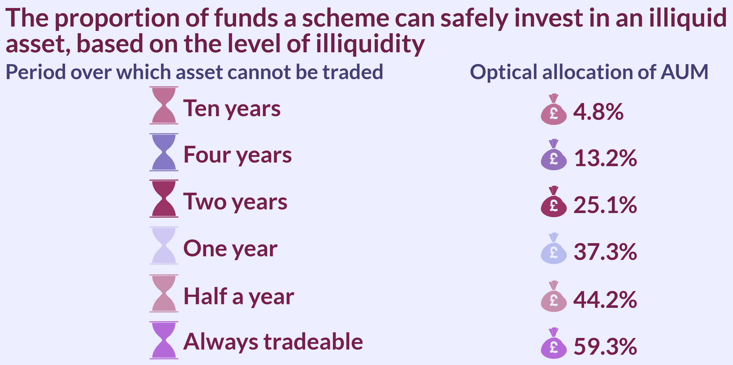
There are methods of calculating the proportion of funds which can safely be invested in illiquids, for example…
PPI
Pensions Policy Institute
Notes:
Slide 4 simply shows how the 1% charge cap introduced by the stakeholder pensions regime reduced margins very substantially. (It also more or less stopped the growth of pensions provision in the workplace dead in its tracks, but that is another story).
The headline of this slide was a comment on what happens if an industry waits for the Government or regulator to intervene. (Unlike Australia, where the providers took the initiative to eliminate the high early cessation penalties themselves, and introduced flat charges of around 2% - which looked like a stunning reduction at the time, as you will appreciate if you picture a flat line at 2% on this chart - and is only now being seriously challenged, which the industry can stand easily because of the way funds have built up)

Slide 12
An increase in demand from schemes should ideally result in investment and development by platforms…
PPI
Pensions Policy Institute
Alternative funds are not widely available because of:
Platform constraints, particularly around the regularity of asset valuations, and,
Subdued demand due to the administrative complexity associated with investment in illiquid and alternative assets.
Changes in the marketplace, could increase accessibility and encourage innovation and development by asset managers.
Notes:
Slide 4 simply shows how the 1% charge cap introduced by the stakeholder pensions regime reduced margins very substantially. (It also more or less stopped the growth of pensions provision in the workplace dead in its tracks, but that is another story).
The headline of this slide was a comment on what happens if an industry waits for the Government or regulator to intervene. (Unlike Australia, where the providers took the initiative to eliminate the high early cessation penalties themselves, and introduced flat charges of around 2% - which looked like a stunning reduction at the time, as you will appreciate if you picture a flat line at 2% on this chart - and is only now being seriously challenged, which the industry can stand easily because of the way funds have built up)

Slide 13
Advancements in education and a holistic communication might be necessary…
PPI
Pensions Policy Institute
DC schemes receive most of their information from intermediaries who could be incorporated into education campaigns that aim to help providers and trustees to understand their options and the potential benefits of investing in illiquid and alternative assets.
Education may need to be undertaken directly
with consultants, advisers and platform
managers before being undertaken with
DC scheme providers.
Notes:
Slide 4 simply shows how the 1% charge cap introduced by the stakeholder pensions regime reduced margins very substantially. (It also more or less stopped the growth of pensions provision in the workplace dead in its tracks, but that is another story).
The headline of this slide was a comment on what happens if an industry waits for the Government or regulator to intervene. (Unlike Australia, where the providers took the initiative to eliminate the high early cessation penalties themselves, and introduced flat charges of around 2% - which looked like a stunning reduction at the time, as you will appreciate if you picture a flat line at 2% on this chart - and is only now being seriously challenged, which the industry can stand easily because of the way funds have built up)

Slide 14
PPI
Conclusions
Pensions Policy Institute
Greater DC scheme investment in illiquid and alternative assets could potentially yield benefits to pension scheme members,
However there are challenges facing interested schemes, in particular the lack of funds on platforms and difficulties around charge cap compliance,
The Government and regulators are working on removing barriers though development from asset managers, DC platforms and flexibility from fund providers will be necessary to create more accessibility.
Notes:
Slide 4 simply shows how the 1% charge cap introduced by the stakeholder pensions regime reduced margins very substantially. (It also more or less stopped the growth of pensions provision in the workplace dead in its tracks, but that is another story).
The headline of this slide was a comment on what happens if an industry waits for the Government or regulator to intervene. (Unlike Australia, where the providers took the initiative to eliminate the high early cessation penalties themselves, and introduced flat charges of around 2% - which looked like a stunning reduction at the time, as you will appreciate if you picture a flat line at 2% on this chart - and is only now being seriously challenged, which the industry can stand easily because of the way funds have built up)

Slide 15
DC scheme investment in illiquid and alternative assets Response from Government
David Farrar, DC Investment and Governance

Slide 16
Summary
Reflections on the report
DWP’s principles in facilitating illiquid investments
The changing DC landscape
Government’s consultation

Slide 17
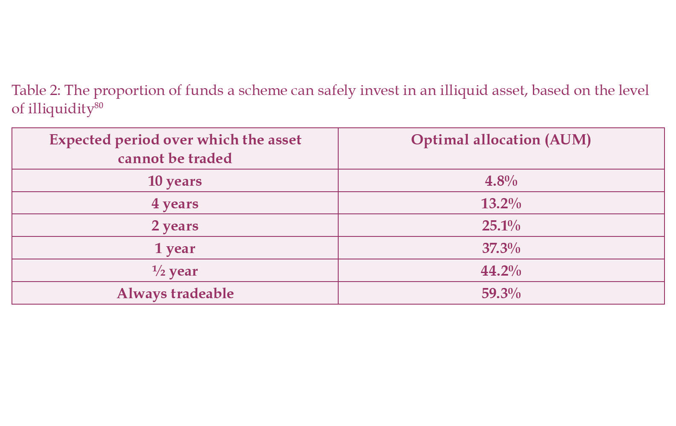
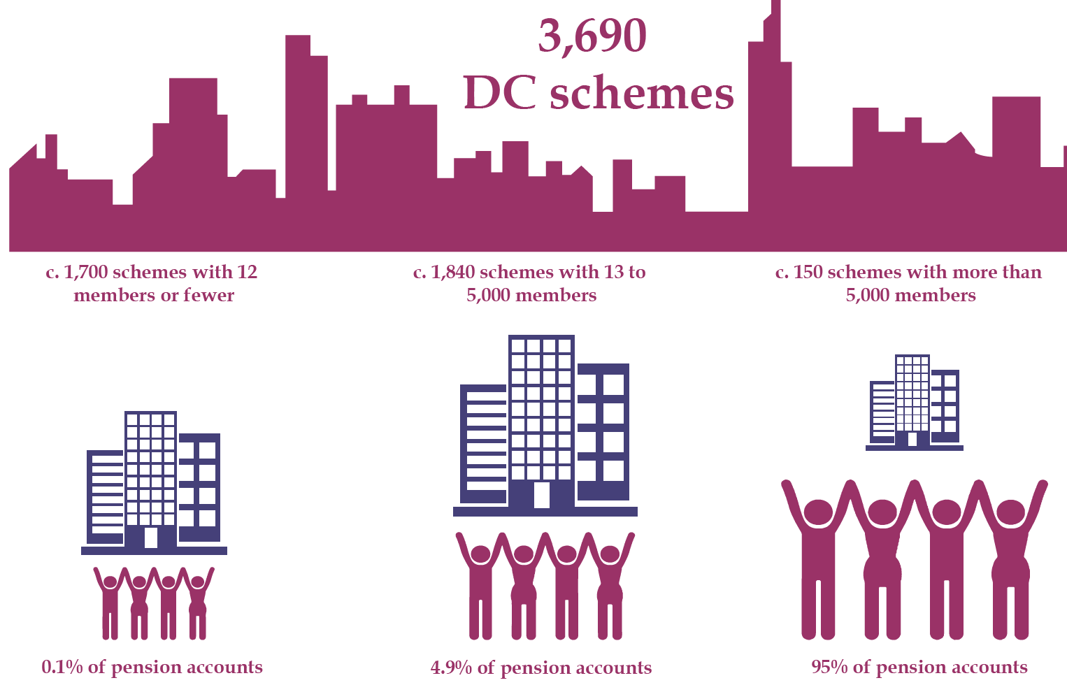
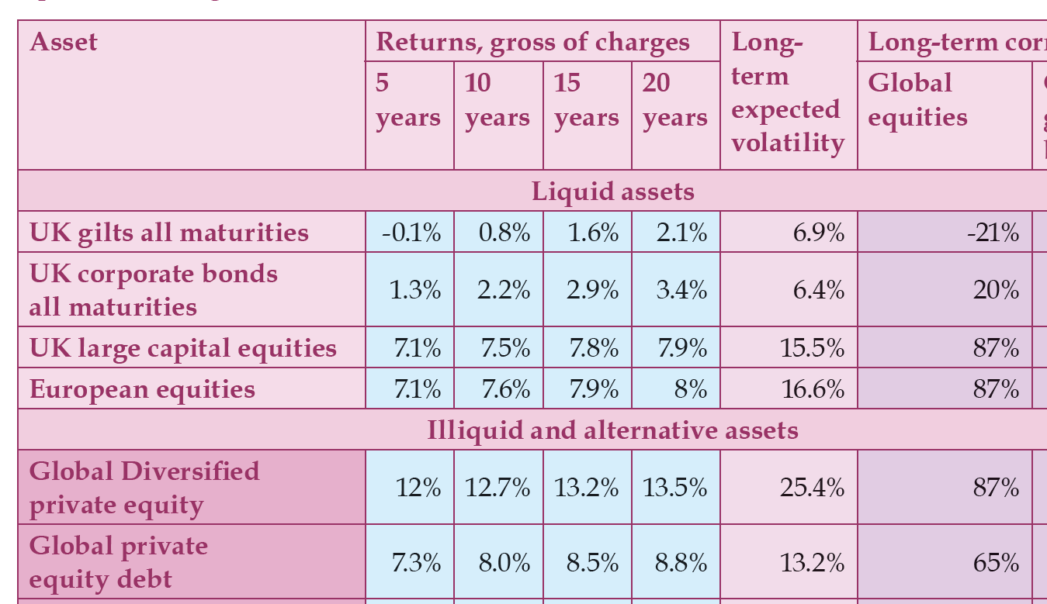
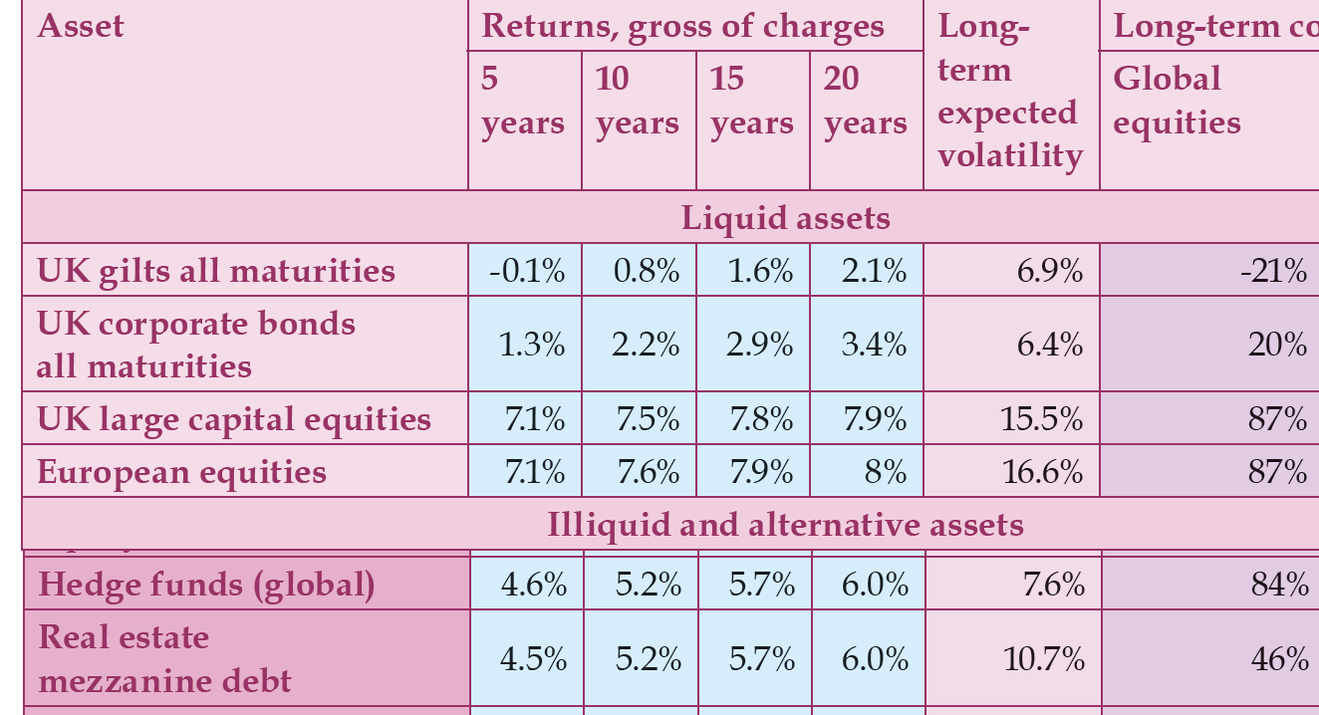
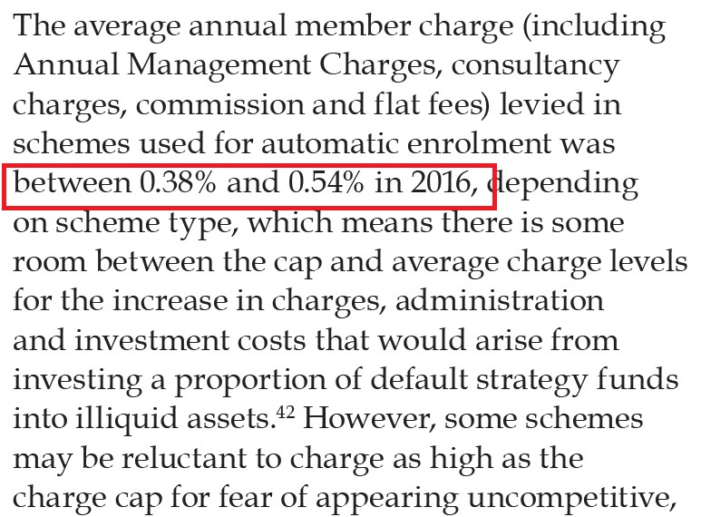
Reflections on the report
A behavioural cap not a legislative one
The illiquidity premium is at least plausible
Scale is already present in DC
Models are available to identify optimal allocations
Hedge funds are still rubbish

Slide 18
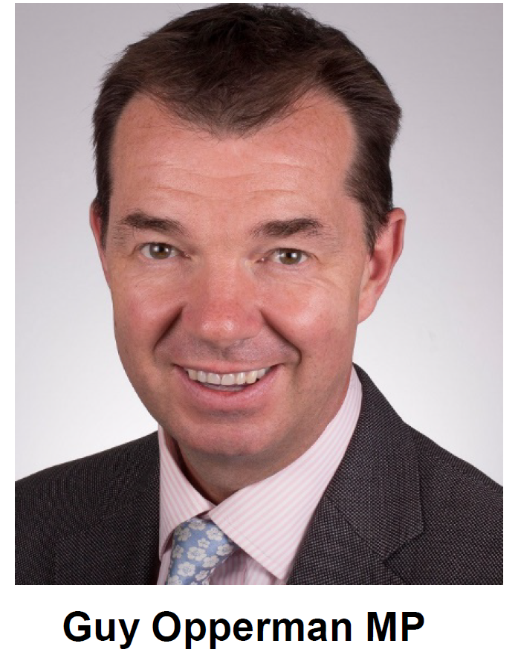
DWP’s principles in facilitating investments
“It remains Government policy not to direct the investment decisions or strategies of trustees of pension schemes. We will never exhort or direct private sector schemes to invest in a particular way. Trustees have absolute primacy in this area.”
No direction
Never more than a nudge to consider
No home bias
No claims of outsize returns
No asset allocation bias, beyond a 0.75% charge cap

Slide 19
Changing DC landscape
90 schemes
But compared with DB …
369 schemes
759 schemes

Slide 20
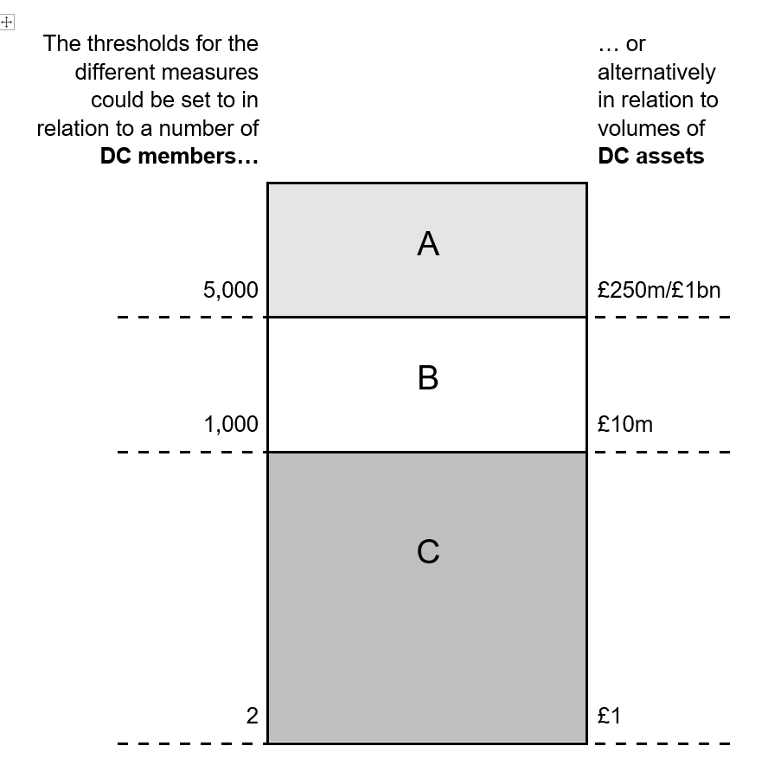
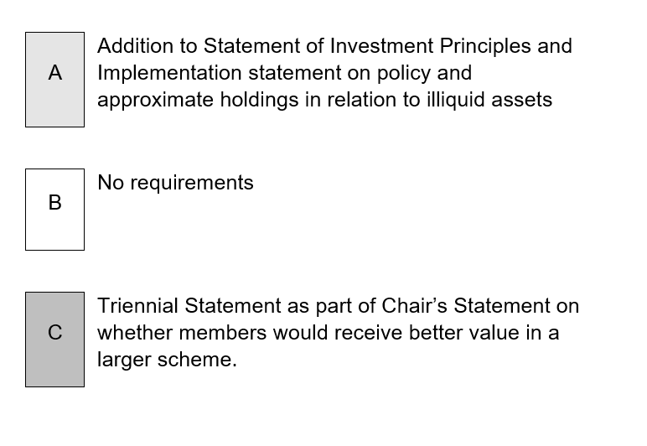
Our consultation 1

Slide 21
Our consultation 2
Performance fees - Additional method of assessment
$$\frac{Fixed rate fee \left(if no change in funds under mgmt\right)\left(£\right)+Max performance related fee (£) }{Year start funds under mgmt \left(£\right)}≤0.75\%$$
Consultation details
https://bit.ly/illiquids - open until 1st April
Respond to
Sinead Donnelly and David Farrar
pensions.investment@dwp.gsi.gov.uk

Slide 22
PPI
Pensions Policy Institute
Response to research findings
Alex Cave,
Head of DC Platforms,
BlackRock
#PPILaunch @PPI_Research

Slide 23
PPI
Pensions Policy Institute
Response from provider
Mark Fawcett,
CIO
NEST
#PPILaunch @PPI_Research

Slide 24
PPI
Pensions Policy Institute
Panel Discussion
Alex Cave
BlackRock
David Farrar
DWP
Daniela Silcock
PPI
Mark Fawcett
NEST
Please observe the Chatham House Rule

Slide 25
PPI
Pensions Policy Institute
Questions and Answers Session
Please observe the Chatham House Rule

Slide 26
PPI
Pensions Policy Institute
Closing Remarks
Please observe the Chatham House Rule

Slide 27
PPI
Pensions Policy Institute
Thank you for attending today…
Please stay and join us for a drink
Thank you to our event & research
sponsors

