Slide 1
What limits workplace pension saving amongst threshold adults (aged 25-39 years)?
Hayley James
Pensions Policy Institute
3rd May 2018
www.pensionspolicyinstitute.org.uk
Notes:
Hi everyone, I’m Hayley, and first I’d like to reiterate Chris’ comments and thank you all for coming.
As mentioned, I’m a PhD student at the MICRA the Manchester Institute for Collaborative Research in Ageing and my research has been kindly sponsored by the Pensions Policy Institute and the Economic and Social Research council.
Today I’m going to give an overview of the findings from my research regarding threshold adults, and in particular the role of financial and social establishment in limiting greater participation in pension saving.

Slide 2
What limits workplace pension saving amongst threshold adults?
Who are threshold adults?
Workplace pension saving amongst threshold adults
Research on pension decisions
The role of financial and social establishment
Notes:
These are the topics for that I’m going to cover
First, who are the threshold adults?
Then what do we know about their workplace saving at the moment?
Third, I’ll give a brief description of my research that has highlighted this topic
Finally, I’ll explain what financial and social establishment is and how it relates to pension participation amongst threshold adults.
Before moving into the discussion.

Slide 3
Who are threshold adults?
Threshold adults are aged 25 to 39 years old
They have passed adolescence and have some (but not all) markers of adulthood
Subjective positioning
“We’re still young” James, aged 30-39 years old
“We feel like fully-fledged adults” Izzy, aged 20-29 years old
Notes:
So to start with – what do we mean by threshold adults?
This is a term that has arisen from the experiences of participants to describe people who have passed adolescence and have some, but not all, of the typical markers of adulthood, such as marriage, parenthood, and so on.
This can occur between 25 and 39 years old – but it’s not about chronological age, it is more a subjective positioning in regards to life status, where individuals think they are ‘still young’ even if they might not be so young.
Very brief illustration where James, who was in his 30s and paid minimum contributions, felt he and his wife were still young and they were not ready to start thinking about pensions, while Izzy who was in her 20s felt that she and her partner were “fully-fledged adults” as they’d bought their house and got stable jobs, and she had increased her pension contributions to the level of increased employer matching.

Slide 4
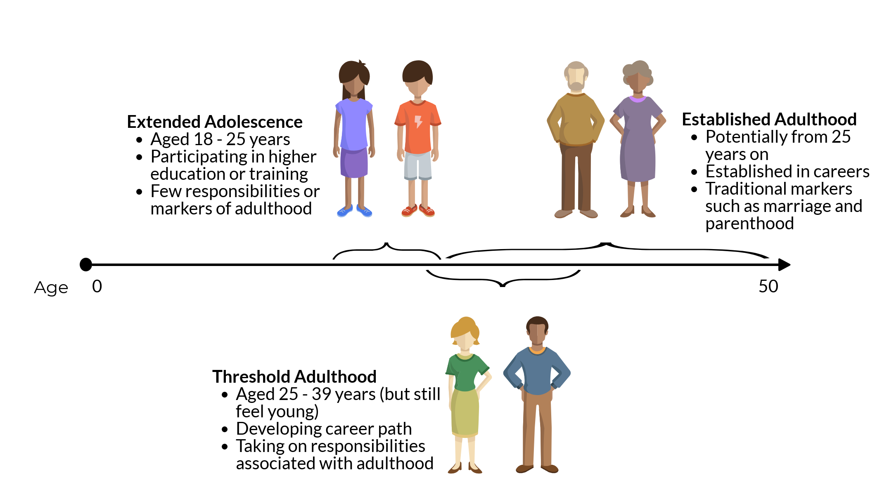
Who are threshold adults?
Notes:
This idea of threshold adulthood connects to extended adolescence, which is a term being used in academic literature about the lifecourse.
Adolescence has become longer, lasting up to 24/25 years old, with people participating for longer in higher education or training with few responsibilities.
Threshold adulthood may overlap to some extent, as young people begin to take on some of the responsibilities of adulthood through an active process of prioritisation of what they think is important to them to be feel established as an adult.
This might happen quickly or slowly, so again highlights the subjective nature of the threshold adult transition.

Slide 5
What limits workplace pension saving amongst threshold adults?
Who are threshold adults?
Workplace pension saving amongst threshold adults
Research on pension decisions
The role of financial and social establishment
Notes:
What do we know about what threshold adults are doing with their pensions at the moment?

Slide 6
Workplace pension saving amongst threshold adults
Workplace pension saving amongst threshold adults has risen substantially since the introduction of automatic enrolment
Participation rose 36 percentage points and 23.4 percentage points amongst 20-29 and 30-39 year olds since 2012
Notes:
We know that workplace pension saving has risen substantially since the start of AE in 2012 and significantly so amongst the 20-29 and 30-39 age groups.
There was a 36 and 23.4 percentage point rise respectively in these groups, compared to 19 amongst 40-49 year olds and 23 overall.

Slide 7
Workplace pension saving amongst threshold adults
Many threshold adults have stuck to minimum contribution levels, and it is unclear whether this will continue as they rise
There is a risk that they may decide to stop contributing altogether
Even increased minimum levels may not be enough to provide for adequacy.
Changes in the pension landscape mean that current and future cohorts may need to save more, and earlier, than previous cohorts to achieve similar levels of adequacy in later life
Existing research has highlighted a reluctance to save amongst threshold adults
This has been described as present bias or myopia, which describe a focus on the present rather than long-term
Also includes the role of optimism bias in over-estimating future resources
Notes:
However, there is some evidence that suggests lots of threshold adults may be paying minimum contributions levels, and we don’t know what will happen as these levels rise. You may already have seen some indication after the first increase in April just gone, yet there is a risk that more people decide to stop contributing as the minimum contribution levels rise to the full levels.
Even at the full minimum levels, saving at this rate may not be enough to provide for adequacy in later life. Previous research from the PPI has highlighted that threshold adults need to save more and earlier than previous cohorts to achieve adequacy.
Finally, research has suggested there is a reluctance to save amongst threshold adults, drawing on behavioural insights around present bias and myopia, which suggest a preference for the present over the future. Also, research has highlighted the role of optimism bias which may lead people to overestimate future resources.

Slide 8
Workplace pension saving amongst threshold adults
Threshold adults face competing financial priorities at a time when they may have lower financial capability
Understanding how threshold adults think about their pension saving (or lack of it) may be important to determine the best approach
Notes:
This highlights the complex situation faced by threshold adults, and suggests that better understanding how they think about their pension saving (or lack of it) in terms of what does or does not drive their pension saving is important to determine the best approach to support them., which was the aim of this research.

Slide 9
What limits workplace pension saving amongst threshold adults?
Who are threshold adults?
Workplace pension saving amongst threshold adults
Research on pension decisions
The role of financial and social establishment

Slide 10
Research on pension decisions
PhD project sponsored by the Pensions Policy Institute and the Economic and Social Research Council
Qualitative research considering individual pension decision-making following automatic enrolment
Interviews with employees of three case-study organisations aged 25 - 45 years old
Emphasis on the participants’ own understanding of their pension decision
Notes:
To give you a brief overview of the research – this PhD project, called Connecting Policy with the Personal, aimed at understanding individual decision-making after automatic enrolment.
It is based on qualitative interviews with 42 employees who were mostly drawn from three case-study organisation who had implemented automatic enrolment.
The research aimed to really consider how participants understood their pension decisions, so privileging their accounts of what they’d done and why.

Slide 11
What limits workplace pension saving amongst threshold adults?
Who are threshold adults?
Workplace pension saving amongst threshold adults
Research on pension decisions
The role of financial and social establishment
Notes:
So, now I’m gong to describe the role of financial and social establishment and how this relates to workplace pension saving

Slide 12
The role of financial and social establishment
Threshold adults may limit their pension participation due to a defensive focus on establishing themselves financially and socially before they feel ready to prepare for their long-term future
They may contribute at minimum levels in the meantime, yet some decide not to contribute in order to prioritise establishment
Notes:
This research found that threshold adults felt that establishing themselves as adults was important, and they needed to do this before they could really think about pension saving.
Some threshold adults were contributing at minimum levels while they were doing this, although they hadn’t really engaged with it, just let it happen – so the power of inertia was working there.
Others had actively decided not to participate at all (either opting out or stopping contributions) in order to dedicate all their resources towards becoming established as an adult.
All felt that once they had achieved establishment, they would then do more to save for the future, usually through increasing their pension contributions. This was borne out by other participants in the research who demonstrated that once they felt established as an adult by achieving the things that were important to them, they had increased their pension contributions – illustrated by Izzy, mentioned earlier, who used the term “fully-fledged adult”, had increased her pension contributions to the level of employer matching.

Slide 13
Factors of financial and social establishment
Notes:
What becoming an adult referred to exactly was different for everyone.
People had various combinations of what they thought indicated being an established adult.
However, there were some consistent factors which came up, which were income, home ownership and major life events, and I’m going to talk through these in more detail.

Slide 14
Income as a factor of establishment
Income is often treated as a driver of pension participation
This research found income to be more of a facilitator once threshold adults felt ready to engage
Participants drew on a subjective understanding of their income, both current and expected
Participants also highlighted the importance of a buffer to protect current lifestyle before committing to more pension saving
Notes:
So first, income. Most of the threshold adults involved in this research were saving at minimum levels and felt this was affordable, but were not ready to contribute any more. To explain this, participants drew on a subjective understanding of their income in relation to their lifestyle and status to determine what was affordable. What this means is that often they said that they couldn’t afford increased pension contributions, but this wasn’t so much that they really couldn’t afford it, but that they felt it was better to use their resources on the things that were important for them at that time – namely, becoming established. This judgement was not just on the basis of current income, but also what they expected to earn in their career. for example, if they were earning 25k now but thought they would earn £100k in the future they felt they’d be better waiting to save for a pension then and for now focus on their goals of becoming established. This isn’t straightforwardly myopic, in the sense that there is some consideration of their future, although there may definitely be an element of optimism bias at play here.
Furthermore, very few participants suggested that there was an objective level of affordability where they would be able to afford greater pension contributions, but income increases did help people to feel more able to afford pension contributions. In this sense income was a facilitator, for example, not saying once I earn X amount I’ll pay in then, but more that once they started thinking about pensions, a subsequent increase would help them feel confident about committing to increased pension saving.
The experiences of participants also highlighted the importance of a buffer in helping them commit to more pension saving, which was either space in their regular income or a separate pot of accessible savings. This was seen as something that would protect their current lifestyle by countering shocks, and that would help them feel more confident in committing to pension saving. It was like preserving the things they’d already established in the present, and were establishing, before they thought about the future. This was something that was referenced by people in the threshold stage, saying they wanted to build or develop a buffer, but also more established adults who suggested the buffer had helped them to engage with pension saving.

Slide 15
Policy considerations
Automatic enrolment may help threshold adults by encouraging them to save at least at minimum levels
Targeting communications to those who are experiencing income increases may encourage saving above this
Schemes such as Save More Tomorrow may be helpful to encourage commitment to pension saving in the future
The importance of a buffer, especially for low earners, to counter shocks and enable threshold adults to feel more confident about committing to greater pension saving
Notes:
In terms of policy considerations…
Most of the threshold adults would probably not have been saving for a pension at all without automatic enrolment, so that is good, but it is important to consider how can we help them to save more?
There is potential to offer more targeted support through communications and interventions tied to income increases, such as Save More Tomorrow, which helps people commit in the future.
The other aspect that seems to deserve specific consideration is developing a buffer, which I know is something that Nest have been looking at in terms of sidecar savings, which is a pot of liquid and accessible savings, as this might help threshold adults feel more confident to commit to pension saving. And perhaps threshold adults do not even think about this as something they need, so some education or facilitation on this could have a knock on effect on pension saving.

Slide 16
Home ownership as a factor of establishment
Threshold adults face challenges in housing markets
Home ownership was a priority for many participants, as it was considered to offer stability in financial and social terms
This may be driven by home ownership as a cultural norm in the UK, but also by lack of stability offered by private rental markets
Notes:
Turning now to home ownership, this was a major priority for many participants for both financial and social reasons.
Some suggested it was an investment, using very financial language about returns, and some felt it was a better investment than putting money into a pension. This didn’t always prevent them from pension participation altogether, but some had opted-out in order to dedicate all of their disposable income into housing investments.
All of the threshold adults also described home ownership as a platform for social stability in their lives, in terms of knowing where they were going to live, what they needed to pay to live there, offering a home for their current or future families. These things helped them to feel established in their adult lives.
However, this may be related to the strength of norm of home ownership in the UK, where most people expect to own their home, although this is complicated by challenging housing markets faced by threshold adult. This raises the question whether greater stability in rental markets could provide the same sort of social stability which would help them feel more established and ready to think about their futures. This was highlighted by some participants.

Slide 17
Policy considerations
Home ownership is a health goal and perhaps paying minimum pension contributions while saving for a house is enough in the short term
However, as minimum levels rise, this may force threshold adults to take a more active decisions which could lead to deciding not to contribute to their pension
Again, there is a potential role for targeting support and communications to help threshold adults through these competing demands
Also, there is a need to consider those who are not able to purchase a home
Notes:
In terms of policy considerations then:
We might recognise that home ownership is a positive goal for threshold adults, and that maybe it’s enough to ask them to just pay minimum contributions.
But then this still flags the risk around rising minimums and whether this might trigger more active prioritisation of saving for a home in the short-term, as well as concerns about adequacy in later life.
The other major point is what about those who are not able to purchase a home – if they are stuck at this threshold phase, does this limit their ability to think but the future? How can more stability be offered to people who are not able to own their home?

Slide 18
Major life events as a factor of establishment
Age alone did not drive engagement with pension saving since threshold adults took a subjective view of their age position
Instead, participants related establishment to major life events, such as getting married or having children
Participants suggested they provided a platform for preparing for the future
Notes:
So now major life events.
As mentioned earlier, there was evidence that threshold adults subjectively positioned their age-status, in terms of feeling they were still young during the threshold adult phase. This meant that their establishment as an adult was not related to age as much as it was related to the context of their perceived age-status, and the things they had achieved. This often involved major life events, such as getting married or having children.
Many participants felt they would think about pensions once they were married or had children. This was usually not about affording the contributions (as in fact, it might be easier to afford before you’ve been through these key milestones) but instead about being ready to engage with thinking about the future and pension saving. Major life events seemed to provide a platform for thinking about the future, and these were positive factors in encouraging threshold adults to engage with pension saving.

Slide 19
Policy considerations
Automatic enrolment may help encourage saving at minimum levels, although some threshold adults may decide to opt-out
Targeted communications and support based on these transitions, linked to existing touchpoints, such as notifications to HR of life changes
However, must also consider the gendered impact of such life events, as women who have children accumulate lower pension entitlement
Notes:
Similar to what was mentioned before, there is a possibility to use existing touchpoints to engage with threshold adults who are going through such life events and offer support for them. So for example, where people make HR aware that they are expecting a child, this might be a point to share information. This could also work like Save More Tomorrow but related to life events, if people could plug in a future date where they wanted their contributions to start, after they’ve gotten married or something.
But also, an important point would be to consider the gendered impact of these events, as women who take career breaks to have children accrue much lower pension entitlements. There is a tension here, if threshold adults feel that having children is a marker for engagement with pension saving, but they are less able to afford contributions when this happens – which could lead to frustration on behalf of the threshold adults (something which was suggested amongst participants, although only a few people were in this situation). How best can this be supported – its probably not quite so easy as just telling them to save earlier!

Slide 20
Conclusion
These findings highlight the subjective nature of establishment amongst threshold adults, and how this may limit their participation in pension saving
Threshold adults may need specific support to help them prepare for later life, recognising the complex situation they face.
This raises important policy considerations as to how this might be addressed, such as the use of targeted communications and interventions.
Notes:
So to wrap up then,
This research has highlighted the experiences of threshold adults and the subjective nature of becoming an adult. This has shown how threshold adults feel the need to prioritise establishment and this may limit pension saving amongst threshold adults.
Threshold adults may need specific support which recognises the complex situations they face, and this raises a number of policy considerations regarding how best to deliver this support.
Thanks very much for listening, and I look forward to forward to hearing your thoughts.

Slide 21
We’d like to thank...
The Economic and Social Research Council (ESRC), the UK's leading research and training agency addressing economic and social concerns, for funding this 3 year PhD studentship.
Grant number ES/J500094/1.

